Slide 1

Mass-Mail Dispatcher WebSite
EXPOSYS DATA LABS
Submitted by - HRitiK Kumar Gupta

Slide 2
ABSTRACT
This project is web-based mass-mail dispatcher is designed to send mass mails to all the recipients uploaded through a csv file. The application will list and sort out all the valid and invalid emails detected by the application in the csv file.

Slide 3
Table of Contents
1.Abstract
2. Introduction
3. Existing Method
4. Proposed method
5. Methodology:
Methodology No 1
Methodology No 2
Methodology No 3
6. Conclusion

Slide 4
Introduction
WEB DEVELOPMENT PROJECT :- “Design and Develop Website Mass-Mail Dispatcher”
The system have been working with in this project is the web-based Mass-Mail Dispatcher.
The application is designed to send mass mails to all the recipients uploaded through a CSV file.
The purpose of this is to provide a tool to control and send emails to a vast number of recipients emails.
The application will list and sort out all the valid and invalid emails detected by the application allowing the users to more readily send emails as per user convenience.
The end user should be able to upload CSV file.
The application shall list the detected invalid emails found in the CSV File.
The user should be given a structured list of the valid emails.

Slide 5
Existing method
There are many websites which validates the Email But not in the large no of emails within a Second.
Many online website exists which can be used to send mail in bulks using API .
Issues in existing systems-
Send one email at one time using the Server .
Expensive.
Such website will not validate mails.
Less interactive.

Slide 6
Proposed method
The Website with Validation as well as Mass Messaging System for vast no of Emails.
Design & Style the Home Webpage.
Apply the JavaScript on page to take the Csv file(containing emails) from User.
Apply JavaScript which helps in validation of all the Emails and Sorted into valid & Invalid Emails List.
Display All the Valid Emails & Invalid Emails.
Design A Send Page Where We Can Send the Mass Mail to All the Valid recipients Emails in the Csv File.

Slide 7
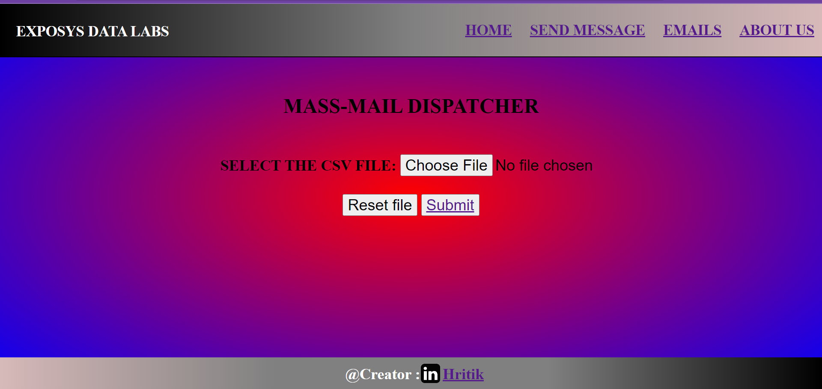
Methodology No.1
1. Creating Home Page:
With the Use of HTML, CSS & JavaScript, Created Webpage having Home page, Send Message Page, Emails page, About Us which is link to Exposys Data labs website & the Contact link of Creator.
After Submitting the Csv file into the input location of Home Page. JavaScript will Work, Email Validation Occur in the file Containing Emails.
The Data of all Valid & invalid Emails in the file is Stored in the JS Storage and Transfer the data into the Emails Page. That is Link to the Submit Button.

Slide 8
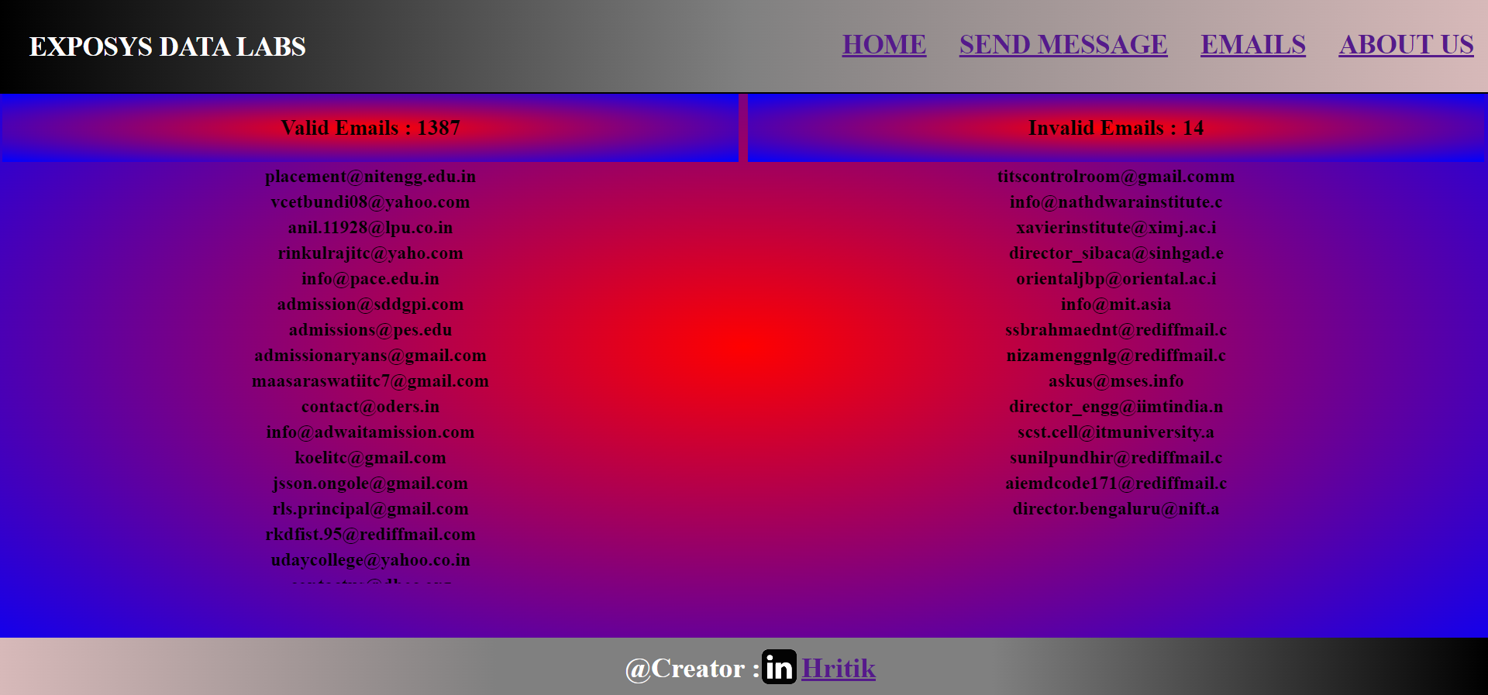
Methodology No.2
2. Creating Emails Page:
With the Use of HTML & CSS Created Webpage having Tables of Heading Valid & Invalid.
By the Use of JavaScript we Fetch all the List of Valid emails & Invalid emails data along with Counting that will Display in the Body of Table .
Now If We Wants to Send Mass Mails to recipients Click on the Send Message button in Navbar which is Directly Link to Send Message Page.

Slide 9
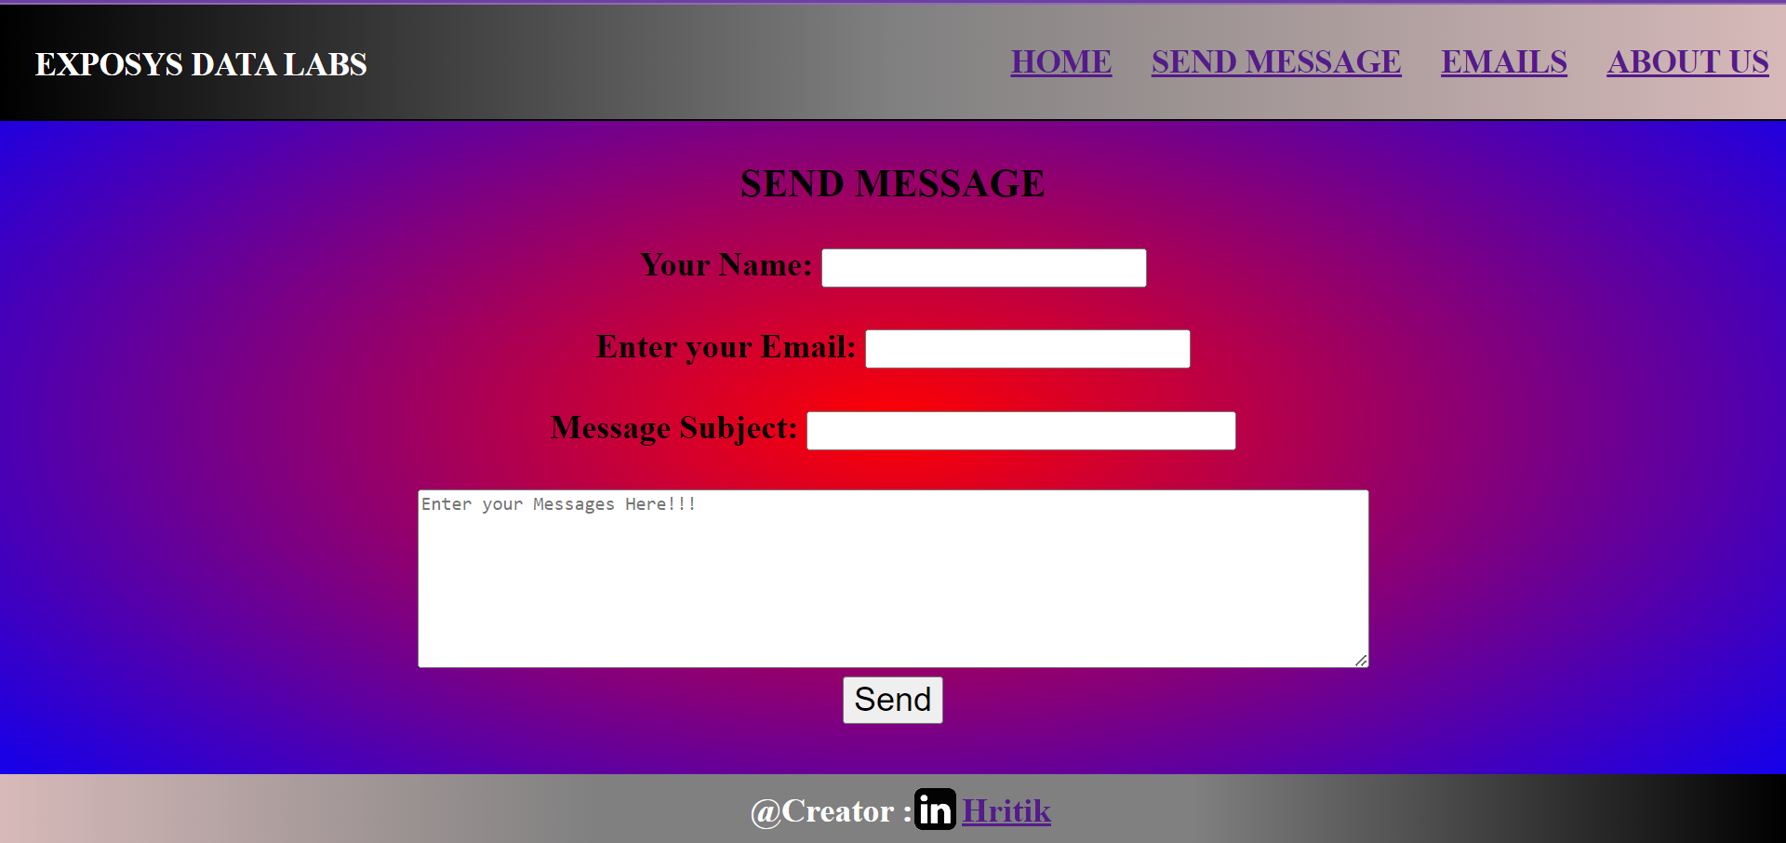
Methodology No.3
3. Creating Message Page:
With the Use of HTML & CSS Created this Page which will take all required inputs from the user to Send Message through Email Service.
By the Use of JavaScript local Storage we Fetch all the valid Emails lists.
After Clicking the Send Button JS will Establish the Connection With the SMPT Server and Run the Script for every emails and sending Message to the vast no. of recipients within a Seconds.

Slide 10
Conclusion
The Project is Successfully Completed and Working Which really helps to the people who wants to check the Valid and Invalid Emails in the Lists of Vast no of Emails data and Also Send the Mass Mails to the large no of recipients.
Skills of Web Development is Very Helpful to Successfully Complete this Project.

Slide 11
THANK YOU
EXPOSYS DATA LABS
Submitted by - HRitiK Kumar Gupta

